Slide 1


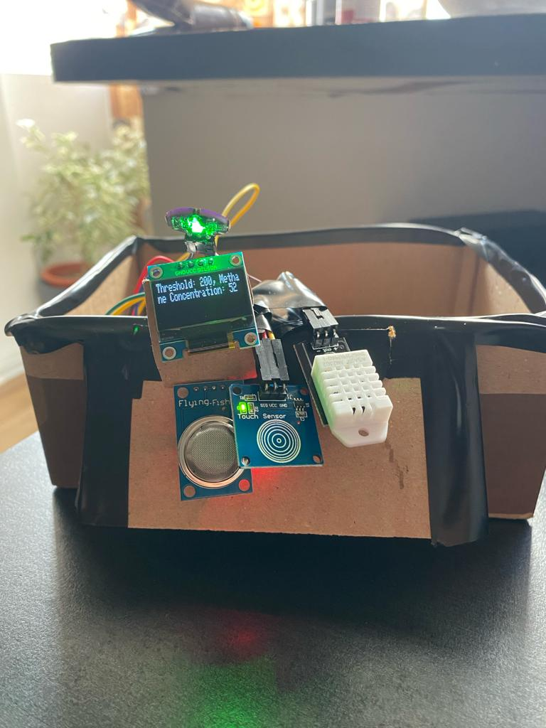
Multi Sensor Monitor
A Comprehensive Sensor Monitoring System
EMS Project
Roşianu Sebastian
Staic Catalin
Orian Teodor Octavian
Group 30423_2

Slide 2
Understanding the MultiSensorMonitor
The MultiSensorMonitor serves as a powerful tool, providing real-time data on various environmental parameters.
Throughout this presentation, we will uncover the functionalities, applications, and inner workings of the MultiSensorMonitor. Whether you're interested in home automation, health tracking, or environmental monitoring, this device offers valuable insights. Join us as we delve into the capabilities of this advanced sensor system, highlighting its role in facilitating informed decision-making.

Slide 3
Essential Components
Gas Sensor (MQ-4):
Detects methane concentration in the surrounding air.
Provides insights into air quality and potential hazards.
DHT Sensor:
Measures temperature and humidity.
Essential for understanding the environmental conditions.
Pulse Sensor:
Monitors heart rate (BPM).
Offers real-time insights into cardiovascular health.
Capacitive Touch Sensor:
Enables intuitive user control.
Facilitates seamless navigation between monitoring screens.

Slide 4
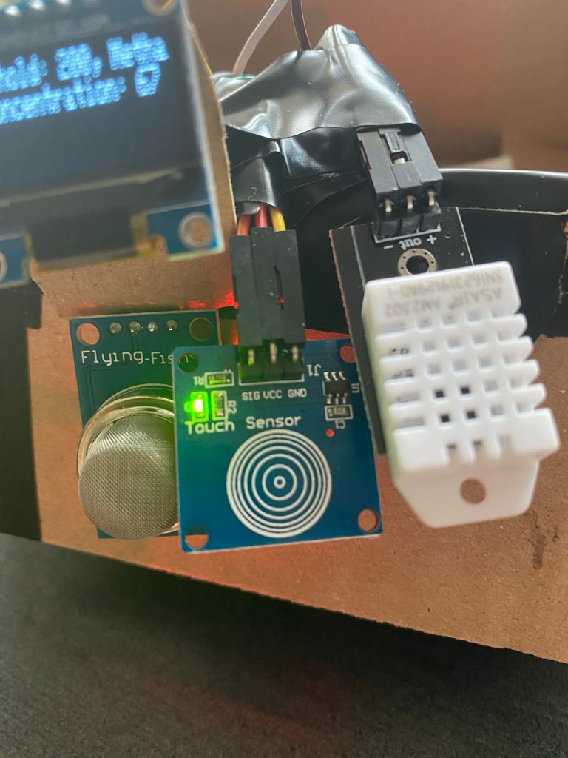
Seamless Control with Touch
Capacitive Touch Sensor:
Facilitates seamless navigation between different screens.
User-friendly interface allowing effortless switching between modes.
Enhances the overall user experience by providing control at your fingertips.
This touch sensor adds a layer of interactivity, making the MultiSensorMonitor not just a passive observer but an actively controlled, versatile tool. Users can effortlessly toggle between temperature/humidity, BPM, and gas concentration screens, customizing their monitoring experience.

Slide 5
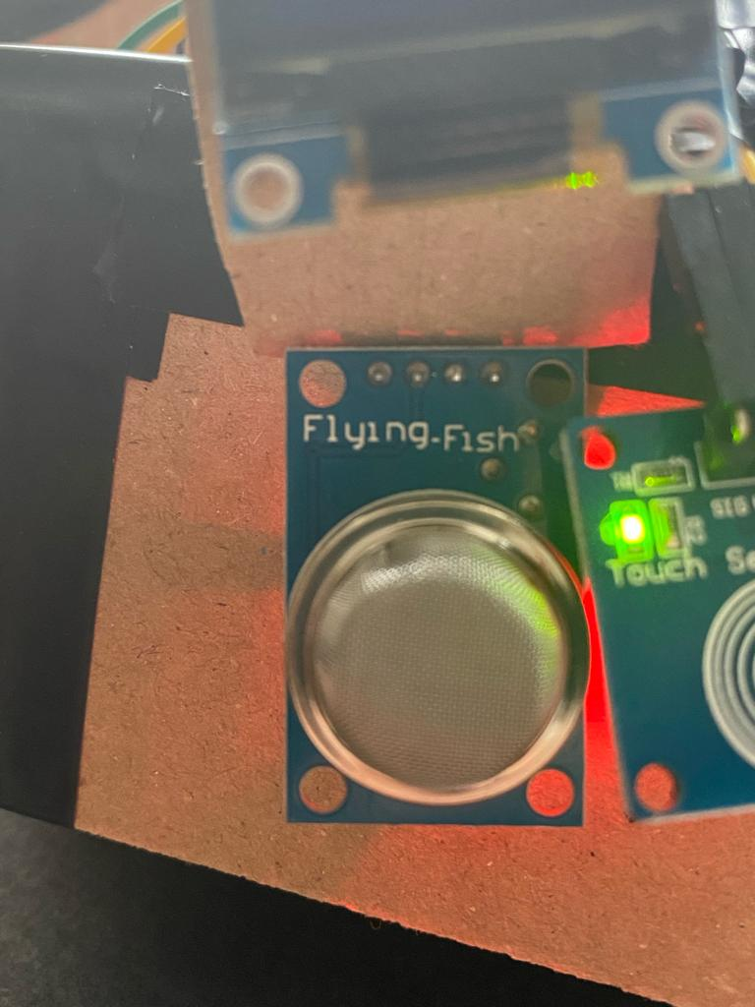
Real-Time Gas Concetration Analysis
Gas Sensor (MQ-4):
Monitors methane concentration in the environment.
Real-time updates on the gas concentration levels.
Adjustable threshold with LED indicator for safety awareness.
Our gas sensor ensures your surroundings are free from hazardous gas levels. The MultiSensorMonitor provides constant feedback, allowing users to set custom thresholds and receive immediate visual alerts if the gas concentration exceeds safety levels.

Slide 6
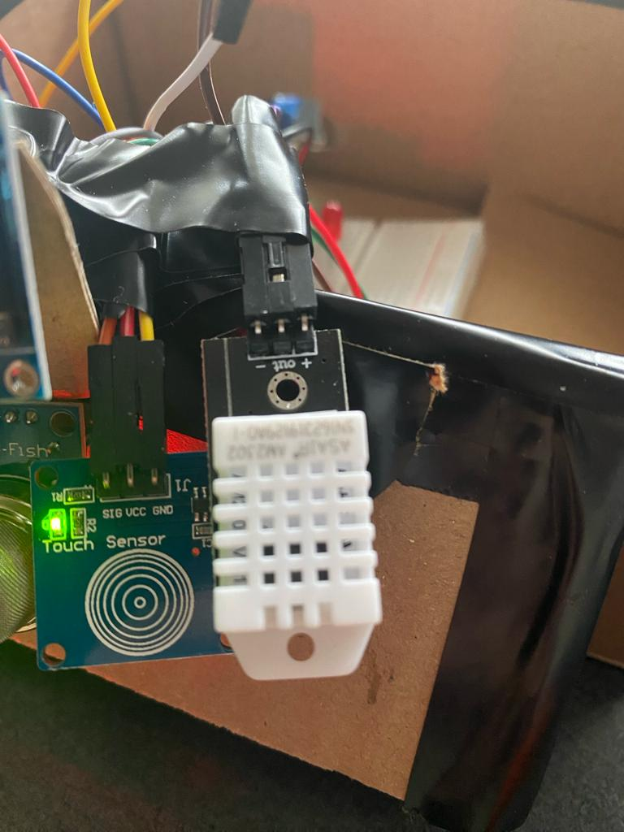
DHT Sensor for Temperature and Humidity
DHT Sensor (DHT22):
Monitors temperature and humidity levels.
Real-time updates on environmental conditions.
Essential for maintaining optimal conditions in various settings.
Our DHT sensor provides accurate readings of temperature and humidity, ensuring that you stay informed about your environment's comfort and safety. The MultiSensorMonitor's real-time tracking helps you create a healthy and comfortable space.

Slide 7
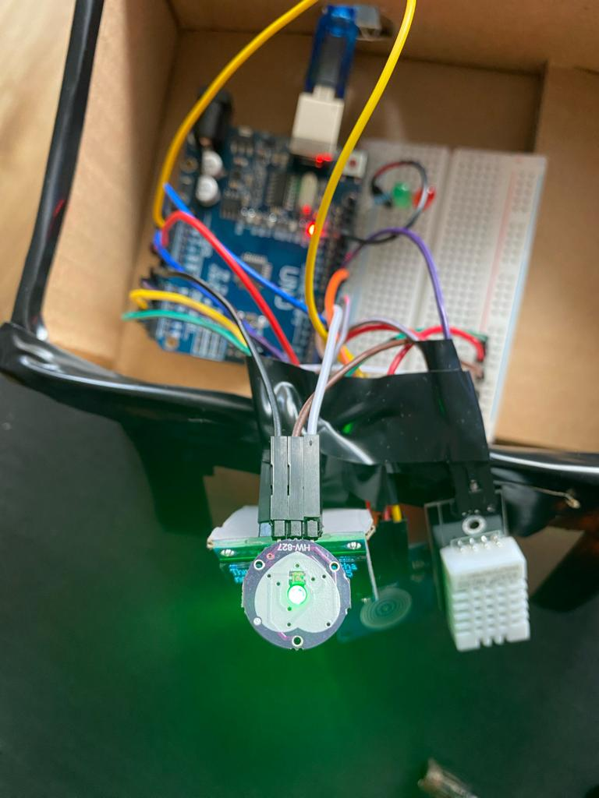
Pulse Sensor for Heart Rate Measurement
Pulse Sensor:
Measures heart rate for cardiovascular health monitoring.
Non-invasive and comfortable design.
Provides real-time data on heart rate variations.
Our Pulse Sensor is designed for seamless integration into the MultiSensorMonitor, offering a non-intrusive way to monitor heart rate. Stay proactive about your cardiovascular health with this reliable and comfortable sensor.

Slide 8
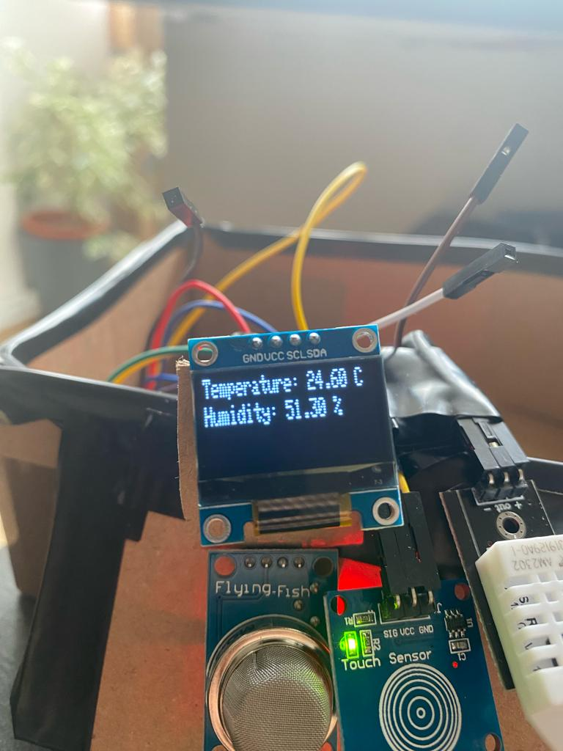
Real-Time Display
Live Data Feed:
Continuously updates vital parameters for instant insights.
Ensures users are well-informed about changing conditions.
Dynamic BPM Readings:
Real-time display of heart rate (BPM) for fitness tracking.
Immediate feedback during physical activities.
Gas Concentration Alerts:
Instant notification of changes in gas concentration levels.
Enhances safety by providing timely warnings.
Temperature and Humidity Updates:
Constantly monitors and displays temperature and humidity.
Offers real-time environmental data for better comfort.
User-Friendly Interface:
Intuitive display for easy understanding.
Simple toggling between different sensor readings.

Slide 9
Versatile Applications for Enhanced Living
MultiSensorMonitor finds applications in various domains:
Health and Wellness:
Monitors heart rate (BPM) for fitness tracking.
Tracks environmental conditions for a healthy living space.
Safety and Security:
Detects and displays gas concentration levels.
Provides real-time information for timely response.
Home Automation:
Integrates with smart home systems for automated adjustments.
Enhances energy efficiency based on environmental data.
Workplace Productivity:
Monitors environmental conditions for optimal work settings.
Supports well-being initiatives in the workplace.
Education and Research:
Engages students in hands-on learning about sensor technologies.
Supports research in areas like health, environment, and automation.

Slide 10
Evolving Capabilities for Tomorrow (except for looks:) )
Integration of Additional Sensors:
Explore compatibility with emerging sensors for comprehensive monitoring.
Continual expansion to cover a broader range of health and environmental aspects.
Machine Learning Integration:
Implement AI algorithms for predictive analysis.
Enhance the device's ability to anticipate and respond to user needs.
Mobile Application Integration:
Develop a dedicated mobile app for remote monitoring.
Enable users to access and control the MultiSensorMonitor from anywhere.
Customizable Alerts and Notifications:
Provide users with the flexibility to set personalized thresholds.
Ensure timely alerts tailored to individual preferences.
Energy-Efficient Design:
Explore energy-efficient components and power-saving modes.
Aim for a sustainable and long-lasting device with minimal environmental impac

Slide 11
Conclusion
Comprehensive Monitoring:
The MultiSensorMonitor integrates diverse sensors for a holistic health and environment monitoring experience.
User-Friendly Interface:
Designed with simplicity in mind, ensuring ease of use for individuals of all technical backgrounds.
Real-time Display:
Experience real-time data visualization for immediate insights into vital metrics.
Versatile Applications:
From health tracking to environmental awareness, the MultiSensorMonitor adapts to various contexts.
Future-Ready:
Ongoing development and future enhancements promise a device that continually evolves with user needs.

Slide 12


